Slide 1


Slide 2

First point on this slide
Second point on this slide
First bullet
Second bullet under second point
Third point, ending slide

Slide 3

Amazing Grace
Hymn 145
Amazing grace how sweet the sound
That saved a wretch like me
I once was lost but now am found
Was blind but now I see
“Amazing Grace” John Newton 1779 England

Slide 4
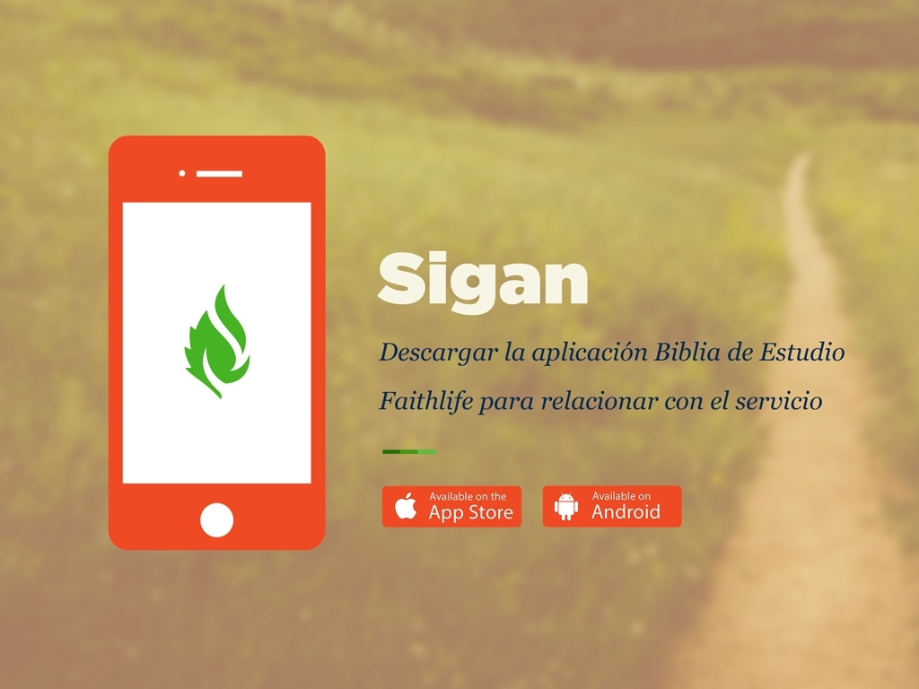

Slide 5
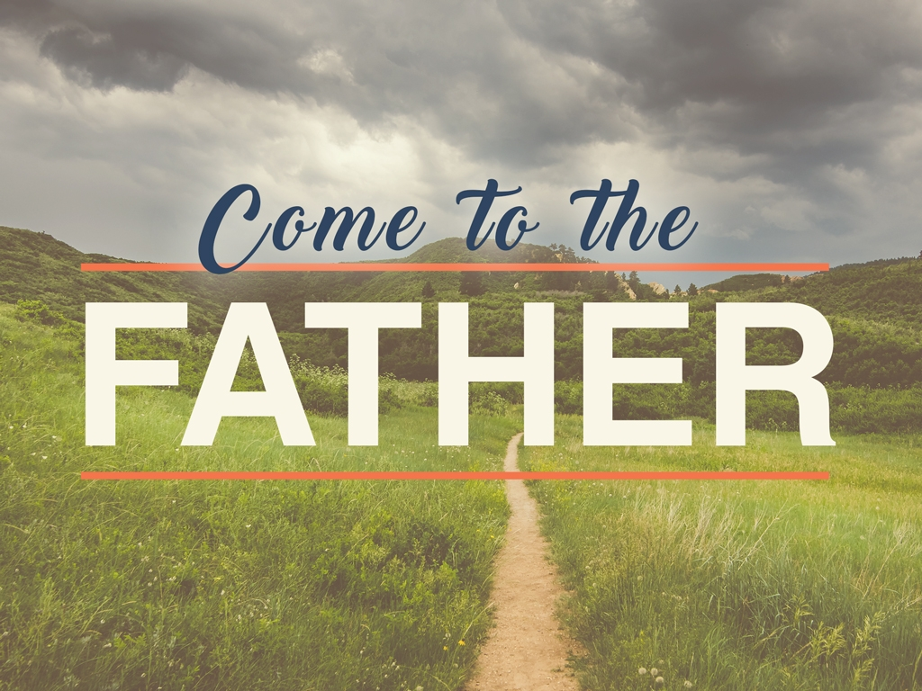
Subheaders Provide More Info

Slide 6

church username

Slide 7

The Header of Things
Subheaders Provide More Info

Slide 8
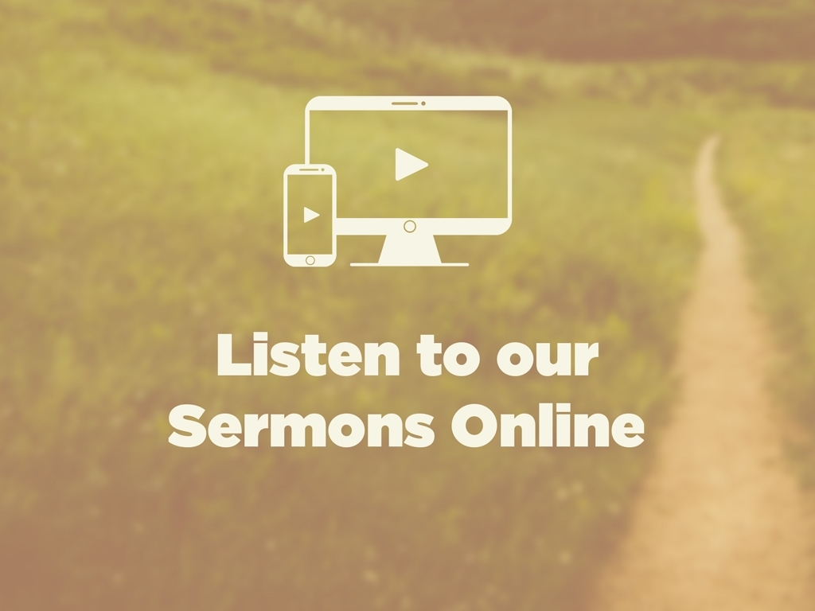
Faithlife.com/ChurchName

Slide 9

churchname.com

Slide 10


Slide 11
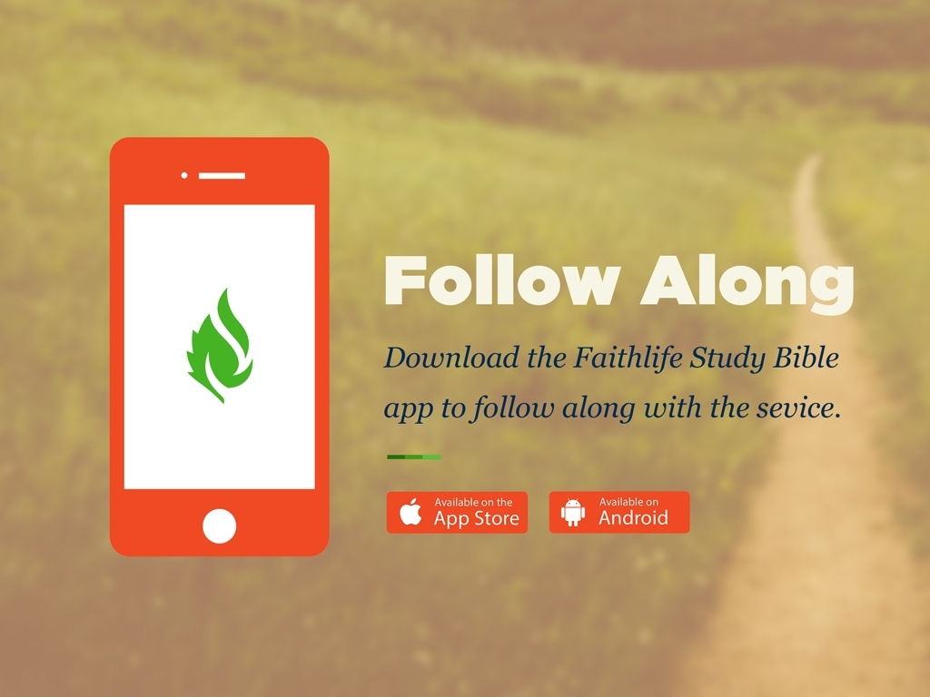

Slide 12
For God so loved the world, that he gave his only Son, that whoever believes in him should not perish but have eternal life.
Bible Verse
ESV

Slide 13

@churchname

Slide 14


Slide 15

Use our digital bulletin!
Faithlife.com/ChurchName

Slide 16
Announcement Title
Information about this event. Additional description of the event.
Church Auditorium, West Campus
Friday, October 13, 8:00–11:00am
Contact: jim@churchname.com

Slide 17

Instagram
@ChurchName
Twitter
@ChurchName
Facebook
Facebook.com/ChurchName

Slide 18

@churchname

Slide 19

Welcome
Church Name

Slide 20

Please silence your mobile devices.

Slide 21
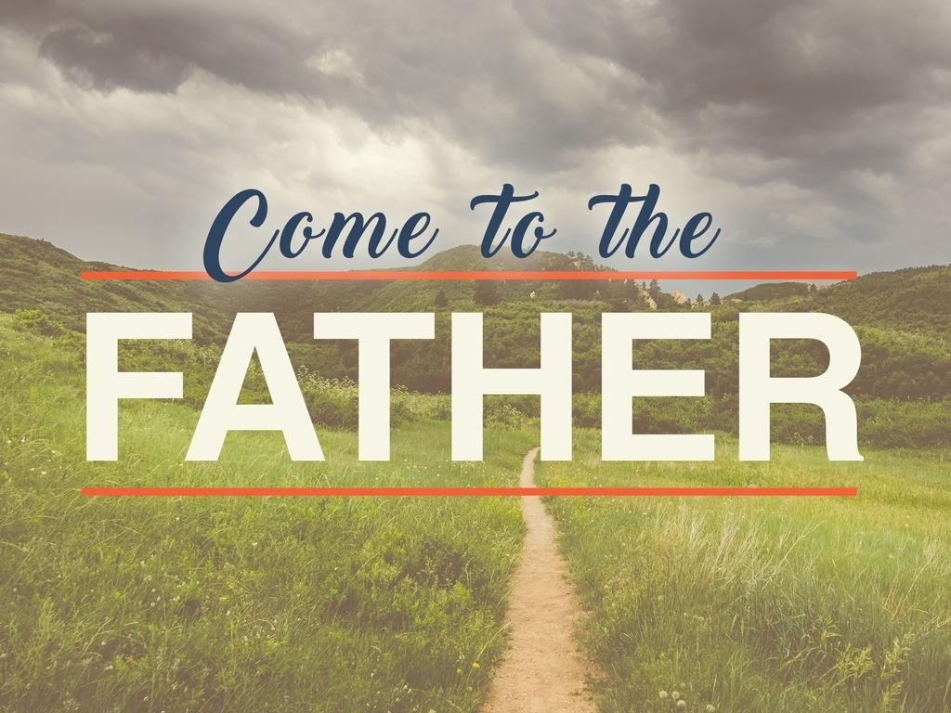

Slide 22

Subtitle of the Sermon
The Title of the Sermon
2 Thessalonians 2:12–3:10

Slide 23

facebook.com/churchname

Slide 24

faithlife.com/churchname

Slide 25

Faithlife.com/ChurchName

