Slide 1

Church Name

Slide 2

John 3:16
ESV
For God so loved the world, that he gave his only Son, that whoever believes in him should not perish but have eternal life.

Slide 3

Please silence your mobile devices.

Slide 4

Faithlife.com/ChurchName

Slide 5
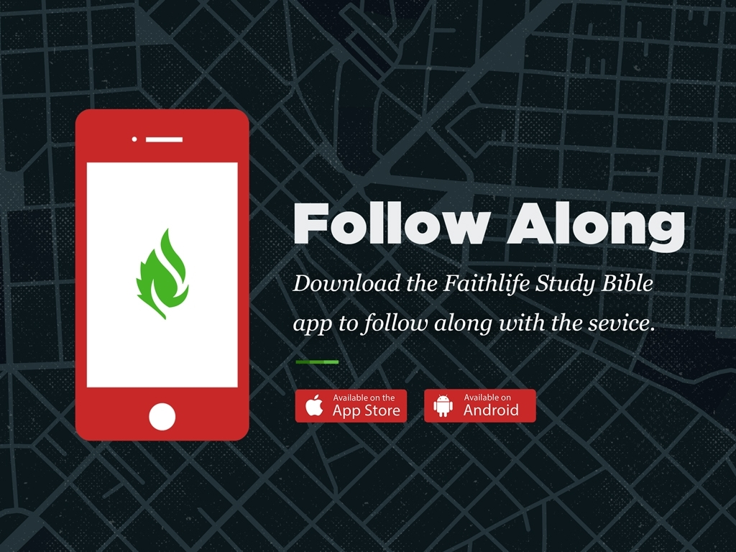

Slide 6

First point on this slide
Second point on this slide
First bullet
Second bullet under second point
Third point, ending slide

Slide 7
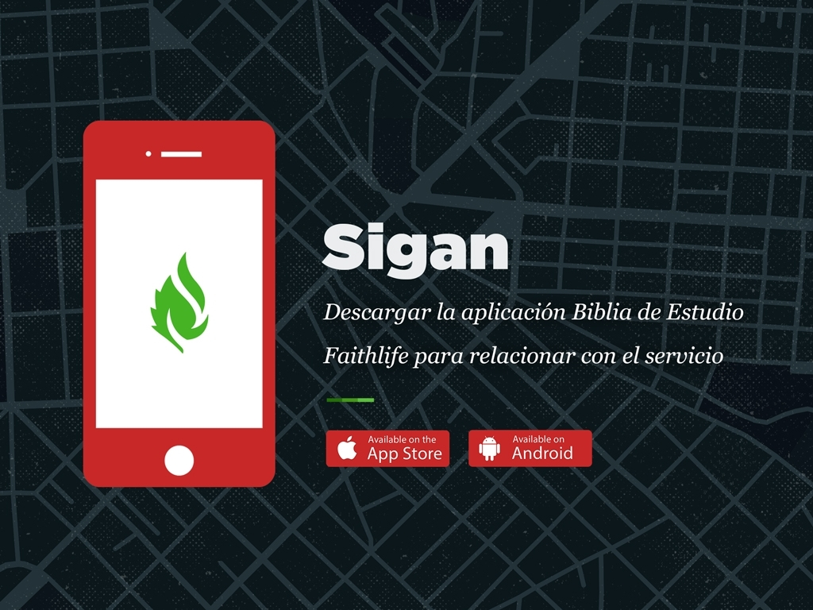

Slide 8


Slide 9
John 3:16
ESV
For God so loved the world, that he gave his only Son, that whoever believes in him should not perish but have eternal life.

Slide 10
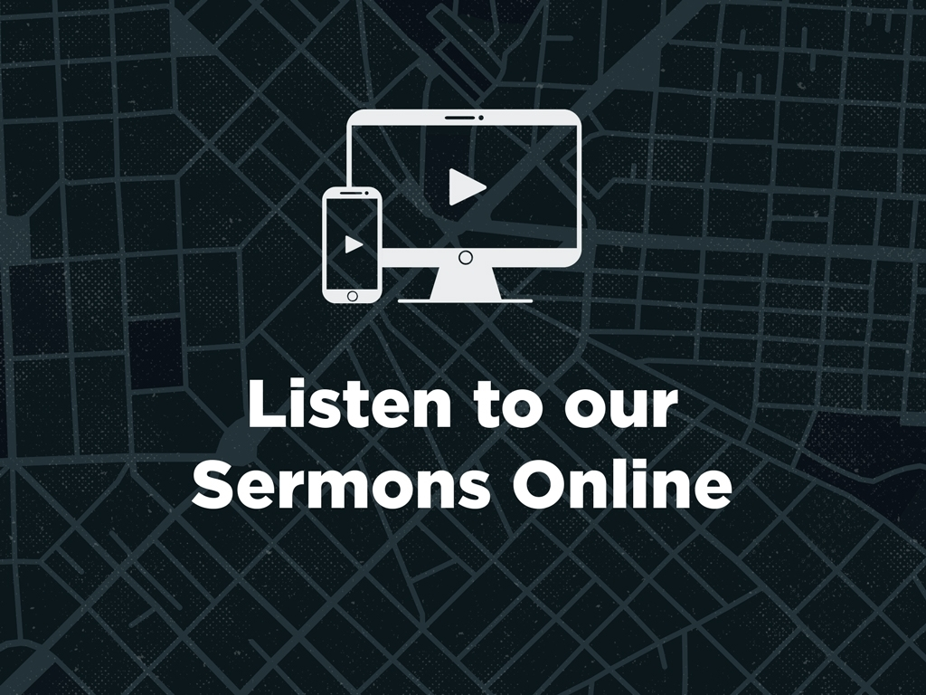
Faithlife.com/ChurchName

Slide 11

The Title of the Sermon
Subtitle of the Sermon
2 Thessalonians 2:12–3:10

Slide 12


Slide 13

church username

Slide 14

Instagram
@ChurchName
Twitter
@ChurchName
Facebook
/ChurchName

Slide 15

faithlife.com/churchname

Slide 16

Subheaders Provide More Info

Slide 17

Church Name

Slide 18

@churchname

Slide 19

churchname.com

Slide 20
The Header of Things
Subheaders Provide More Info

Slide 21

Use our digital bulletin!
Faithlife.com/ChurchName

Slide 22
Announcement Title
Information about this event. Additional description of the event.
Church Auditorium, West Campus
Friday, October 13, 8:00–11:00am
Contact: jim@churchname.com

Slide 23
First point on this slide
Second point on this slide
First bullet
Second bullet under second point
Third point, ending slide

Slide 24
Amazing Grace
Hymn 145
Amazing grace how sweet the sound
That saved a wretch like me
I once was lost but now am found
Was blind but now I see
“Amazing Grace” John Newton 1779 England

Slide 25

Subheaders Provide More Info

Slide 26

@churchname

Slide 27
Announcement Title
Information about this event. Additional description of the event.
Church Auditorium, West Campus
Friday, October 13, 8:00–11:00am
Contact: jim@churchname.com

Slide 28

facebook.com/churchname

Slide 29


