Slide 1

church username

Slide 2

Amazing Grace
Hymn 145
Amazing grace how sweet the sound
That saved a wretch like me
I once was lost but now am found
Was blind but now I see
“Amazing Grace” John Newton 1779 England

Slide 3

facebook.com/churchname

Slide 4
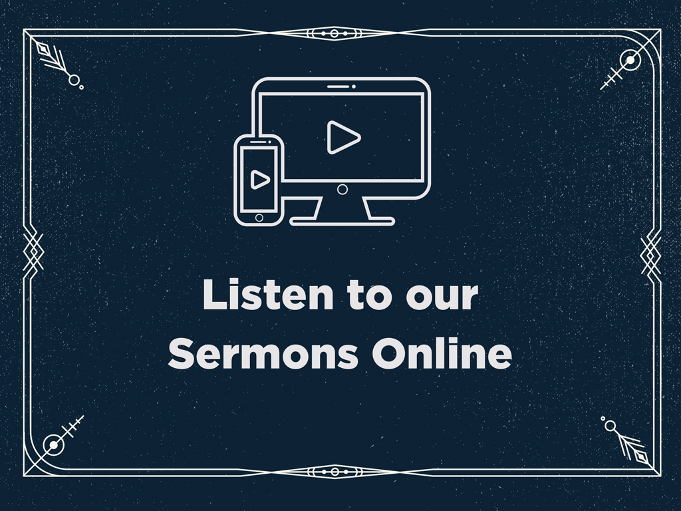
Faithlife.com/ChurchName

Slide 5

Instagram
@churchname
Twitter
@churchname
Facebook
/ChurchName

Slide 6

@churchname

Slide 7


Slide 8

For God so loved the world, that he gave his only Son, that whoever believes in him should not perish but have eternal life.
Bible Verse
ESV

Slide 9

Please silence your mobile devices.

Slide 10
Announcement Title
Information about this event. Additional description of the event.
Church Auditorium, West Campus
Friday, October 13, 8:00–11:00am
Contact: jim@churchname.com

Slide 11

Use our digital bulletin!
Faithlife.com/ChurchName

Slide 12


Slide 13

faithlife.com/churchname

Slide 14

Church Name

Slide 15


Slide 16
The Title of the Sermon
Subtitle of the Sermon
2 Thessalonians 2:12–3:10

Slide 17
The Header of Things
Subheaders Provide More Info

Slide 18
First point on this slide
Second point on this slide
First bullet
Second bullet under second point
Third point, ending slide

Slide 19
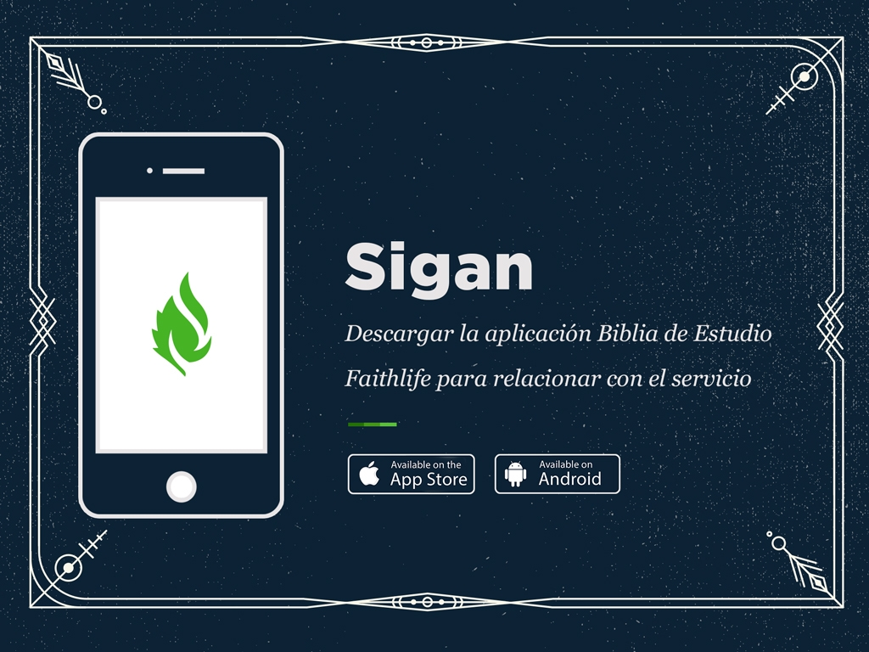

Slide 20

churchname.com

Slide 21


Slide 22

@churchname

Slide 23

Church Name

Slide 24
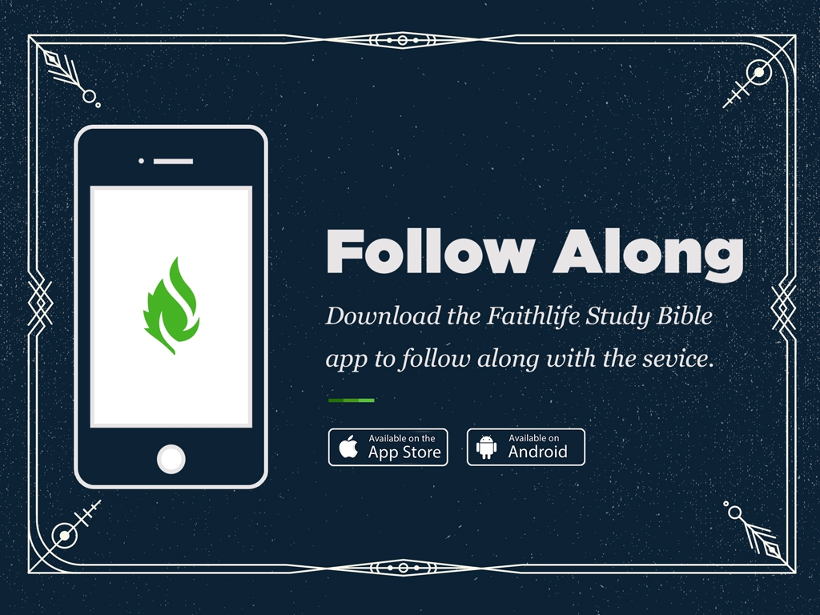

Slide 25

Faithlife.com/ChurchName

