Slide 1
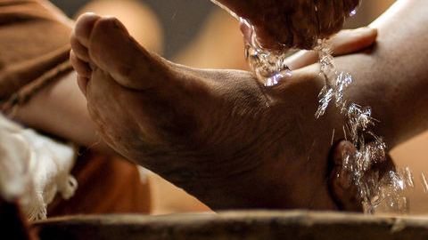
Jesus Washes Feet

Slide 2
BIBLE VERSE

Slide 3
Activity #1
THE GIGGLE MONSTER
Directions: The teacher (or parent) is the Giggle Monster and no matter what they say or do, the kids must try not to smile or giggle. If they do, they’ve been caught by the Giggle Monster and must sit down.
Teacher/Parent: begin making silly faces and noises or do silly things to make the kids smile or laugh. When someone laughs, they’ve been caught by the Giggle Monster and must sit down. In order to escape, they must answer the question below. After answering, they become the Giggle Monster.
Question: Jesus served his disciples by washing their feet. What can you do to serve or help someone?

Slide 4
VIDEOS https://www.youtube.com/playlist?list=PLadc9fo1pca8vNbAsDhn4CM9Ug-2eOPc3

Slide 5
MUSIC VIDEO: “WANNA BE LIKE JESUS”

Slide 6
MUSIC VIDEO: “GONNA SERVE”

Slide 7
Activity #2
Back Words
Lesson Review: The world tells us that first is best and last is worst, but Jesus teaches us to do things backwards. We’re going to play a backwards game right now that will help us think of some ways we can live backwards and put others before ourselves.
Directions: Pick a child to read the sentences from the list below—backwards (i.e. read the last word first and first word last.)
When another child thinks they know what the sentence says, they should jump up, turn backwards and say it. it doesn’t have to be word for word.) If the answer is correct, everyone does a happy dance. If the answer is incorrect, allow someone else to give their answer.

Slide 8
Activity #2
SENTENCES (PAGE 1)
Let your brother chose which TV show to watch.
Help your mom set the dinner table.
Give your old toys to someone who needs them.
Make dinner for your mom when she’s sick.
Let the others get a piece of cake before you do.
Invite a new kid to sit with you at lunch.

Slide 9
Activity #2
SENTENCES (PAGE 2)
Clear the dinner table without being asked.
Let your friend choose which game to play first.
Make your friends a get-well card when they are sick.
Let a classmate get in the lunch line first.
GROUP DISCUSSION
Question: Have you ever done any of those things for someone? How did it turn out? What are some other ways you can serve others or put them first?

Slide 10
EXTRAS
Complete the Shake It Up! sheet.
Check our FaithLife page everyday for more activities!
www.faithlife.com
First Baptist Church of Walterboro
Direct Link: https://faithlife.com/fbc-walterboro-sc/activity

Slide 11
Shake it up!

